Slide 1
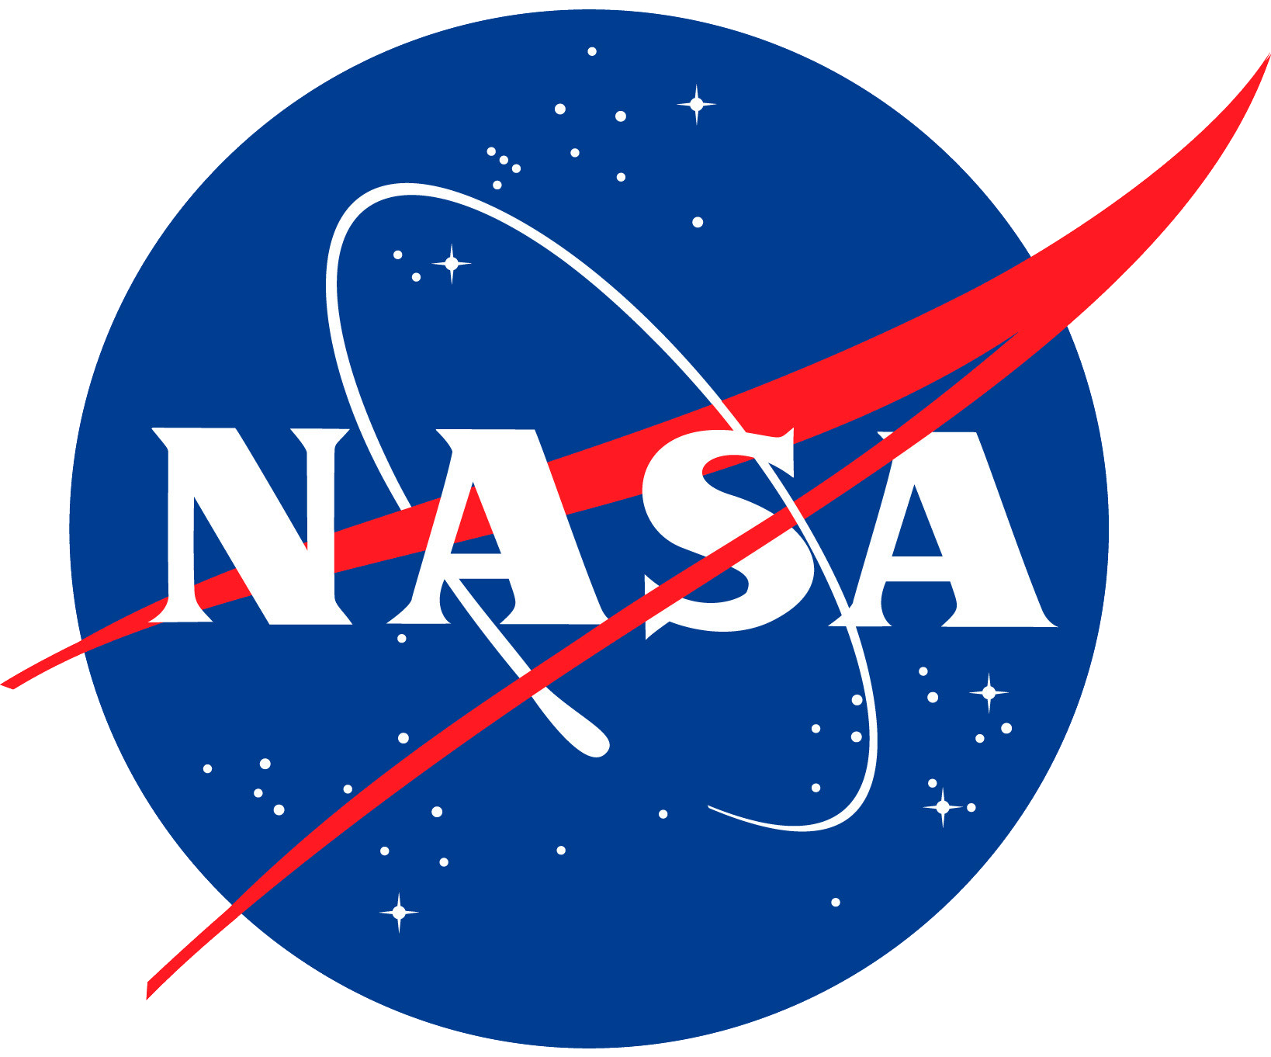
NASA’s Astrophysics Cross-Observatory Science Support (ACROSS) Initiative
Jamie Kennea (Penn State), ACROSS Project Scientist
Brian Humensky, Physics of the Cosmos Chief Scientist Chris Roberts, TDAMM Study/ACROSS Project Manager

Slide 2
PhysCOS TDAMM Study
In October 2022, the Physics of the Cosmos program office initiated a study to identify requirements and formulate implementation options for a TDAMM GOF.
Phase 1 of the study investigated the coordination of NASA space-based missions.
Phases 2-3 of the study (2024-25) will address aspects of NASA space-based mission coordination with ground-based and international facilities.

Slide 3
Summary of Initial Findings: ACROSS
NASA HQ authorized a two-year pilot phase of the Astrophysics Cross-Observatory Science Support (ACROSS) initiative to incentivize and facilitate the planning and execution of TDAMM science cases.
Emphasizing development of cross-observatory science-support tools, operations concepts, and infrastructure to facilitate follow-up observations.
Primary users of ACROSS capabilities are general observers and observatory (mission) science teams.
To incentivize community development of TDAMM cross-observatory science cases, ACROSS is collaborating with mission science teams to develop a general observing competitive research grant solicitation and program, targeting an inaugural call for proposals for 2026.

Slide 4
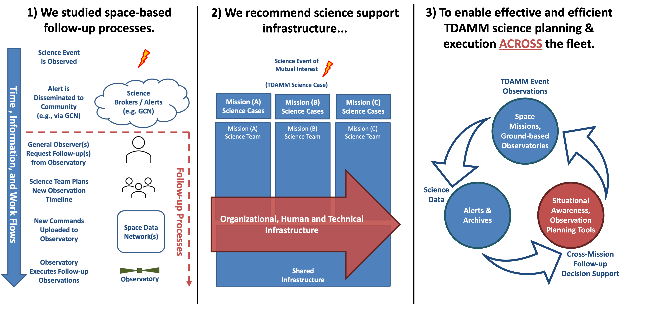
Where does ACROSS fit?
Year 1 of the TDAMM study examined NASA mission workflows, and...
...recommended infrastructure to enable the fleet to operate as a cohesive TDAMM observing system.
The ACROSS Pilot Project was initiated in October 2023 to prototype, demonstrate, and validate means for achieving effective and efficient TDAMM science outcomes.
(ACROSS)
(ACROSS)
ACROSS incentivizes and enables TDAMM science for general observers and lessens the coordination burden on
observatory science operations teams.

Slide 5
ACROSS Activities: Tools
Science Feasibility Tools | Fleet State & Status Information Streams
Pointed Instruments | Target visibility / observability Mission target histories | Long- and short-term observing plans Constraints on planning / scheduling feasibility
Wide-Field Instruments | Whether event of interest was coincidentally detected | When it was last within FoV When it will next be within FoV
ToO Toolkit | Observatory target of opportunity pages
 | API access to allow automatic submission (e.g., for GRB missions, LVK, Rubin transient brokers) "Smart" features leveraging feasibility tools Guide observer in constructing ToO request to reduce workload on observers, mission science teams

Slide 6
ACROSS Activities: Tools
Web Portal | Under development, targeting 2024 release
 | Capability summaries for TDAMM-relevant observatories Links to ACROSS and community-developed tools Links to ToO submission pages for all missions Links to funding opportunities, conferences, and workshops Events of Interest pages, both static (curated by humans, up- dated quarterly) and dynamic (built from near-term observing plans and recent observation history for popular ToOs).

Slide 7
ACROSS Activities: Tools
Research Announcement | Under development, targeting 2026 release
 | An RA targeted at development of tools or observing modes that enable new science cases. An opportunity for funding of DDT observations made by non-flagship missions. An RA designed to fill the gaps between existing mission calls and remove the risk of double jeopardy by explicitly supporting observing programs that require coordination between two or more observatories.
Community Support
 | Joint analysis tutorials and training sessions at the next TDAMM Workshop, anticipated Fall 2024. Planned: Helpdesk – to assist in coordinating “ACROSS” multiple observatories.

Slide 8
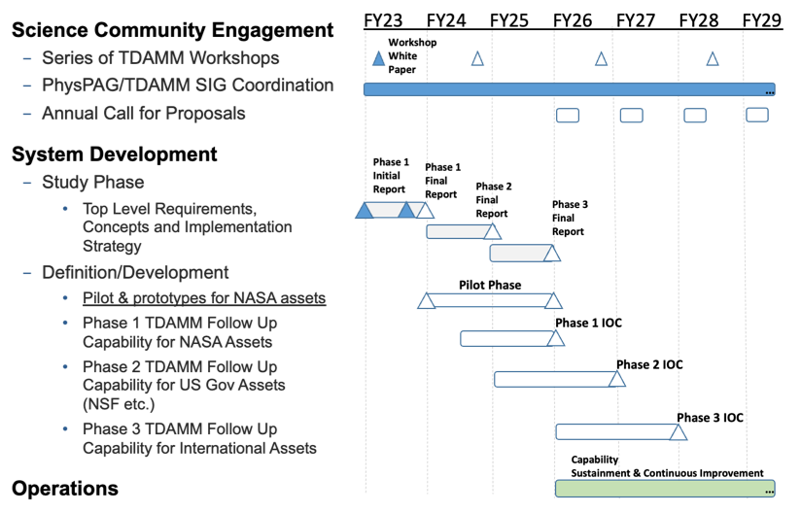
ACROSS Timeline
Phases 2-3 of the study (2024-25) will address aspects of NASA space-based mission coordination with ground-based and international facilities.
Science Planning and Process
PhysPAG/TDAMM SIG Coordination
TDAMM Workshops
Annual Call for Proposals
System Development
Initial Study Phase
Pilot for NASA assets
Phase 1: NASA Assets
Phase 2 US Assets (NSF++)
Phase 3 International Assets
Operations
Capability Sustainment & Continuous Improvement
‘23 ‘24 ‘25 ‘26 ‘27 ‘28 ‘29
Workshop White Paper

Slide 9
Highlighted Recent Accomplishments
Pre-coordinated gravitational-wave follow-up plans among current NASA X-Ray missions and XMM-Newton during the LVK O-4 observing runs.
Each mission provided an overview of its approved general observing programs.
Discussed courses-of-action to ensure effective and efficient follow-ups.
Established an O4-follow-up Slack channel for rapid science team coordination.
Demonstrates a value-added function provided by an ACROSS TDAMM Help Desk.
Delivered a Minimum Viable Product TDAMM web service for BurstCube
Allows BurstCube Science Team to rapidly identify serendipitously observed TDAMM science events detected by others (e.g. LVK).
Supports reprioritization and downlinking of priority science event data.
Serves as a pathfinder for how ACROSS manages and implements value-added interfaces with in-development mission science teams and systems.
Established interfaces to receive NuSTAR near-future/recent-past observing plans
Fills a gap in science situational awareness for both observers and science teams.
Serves as a pathfinder for how ACROSS manages and implements value-added interfaces with current NASA mission science teams and systems.
Informs the design of potential future interfaces with ground-based and international observatory science teams and systems.

